Slide 1
Team Ailuros
Susan Zell
Jose Pacheco
Chris Cooper
Apurva Gupta

Slide 2
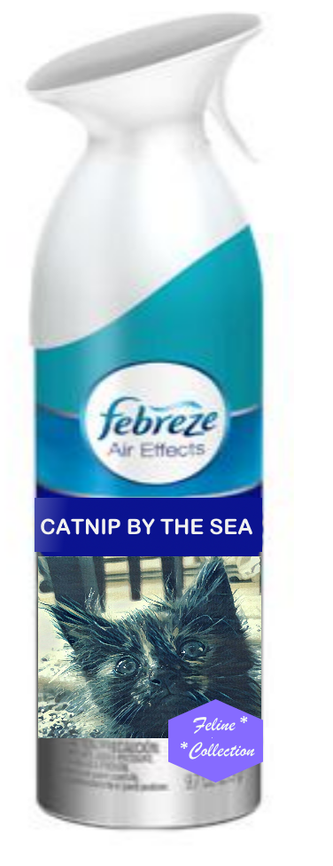

The Scent Connection
You share a home with your pets, but not the same sensory environment
A smart home can help pets and their humans live in harmony

Slide 3
Ailuros Platform
A cloud-based hub for smart pet products
Webhooks for Google Home, Amazon Alexa, Febreze Home, Nest *
Mobile app helps pet owners keep track of pet's health (weight, litterbox usage, food intake etc.) and control or monitor smart devices like air freshener, food/treat dispenser, webcam, pet door, deterrents to extinguish
unwanted behaviors
*At hackathon we focused on Google Home connection to Febreze Home

Slide 4
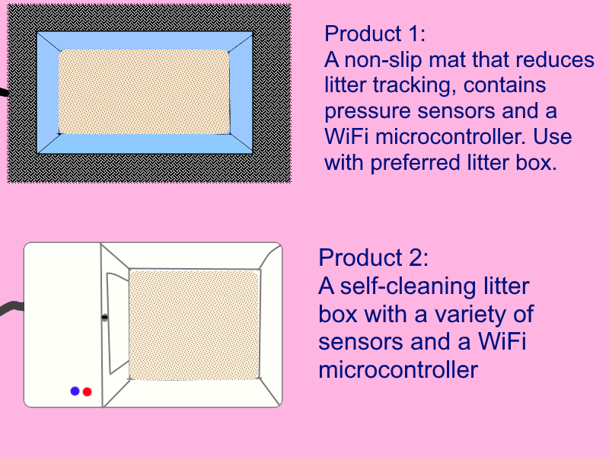
Smart Litterboxes

Slide 5
Smelly Cat + Febreze + IoT
Step 1: Set up smart litter box/litter-catching mat or webcam, connect to home wi-fi network and Ailuros account
Step 2: Middleware uses the data coming in from the embedded sensors to infer that a feline urination or defecation event has occurred
Step 3: A web hook would let the middleware send a PUT request to Febreze Home
Step 4: Febreze Home scent-dispersing units in vicinity of litter box go into Boost mode

Slide 6
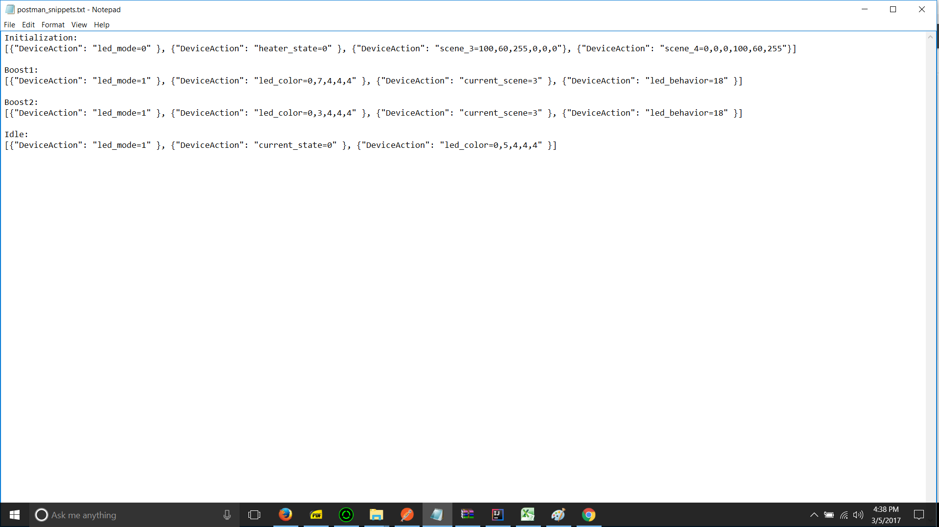
api.ai and arrayent make the magic happen!

Slide 7
Ailuros Mobile App
Control devices like air fresheners, treat dispensers, toys from a smart phone
Data Visualization for Internet of Cats
Set schedules and get reminders and alerts
  Self-Cleaning Litter Box Receptacle Full
  Monthly Flea Treatment Due
  (to Febreze Home:) Extra Shot of Air Freshener at 7:00AM and 5:30 PM
  Cat has not used litter box in 24 hours (could indicate dangerous urinary tract blockage

Slide 8
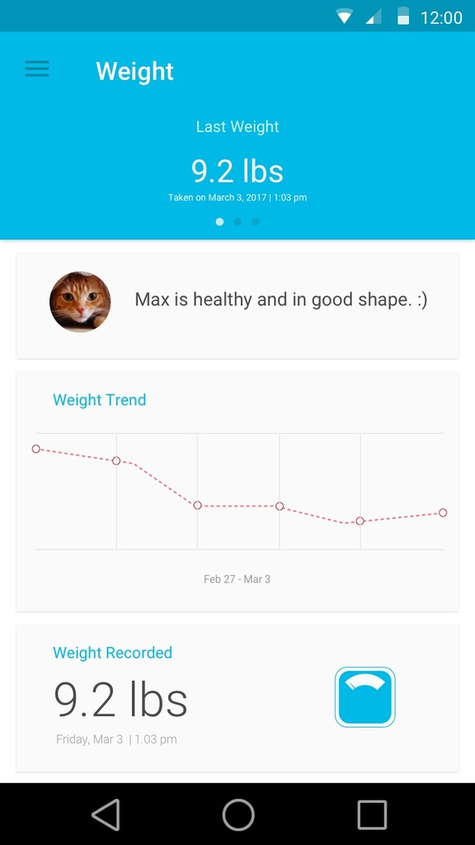
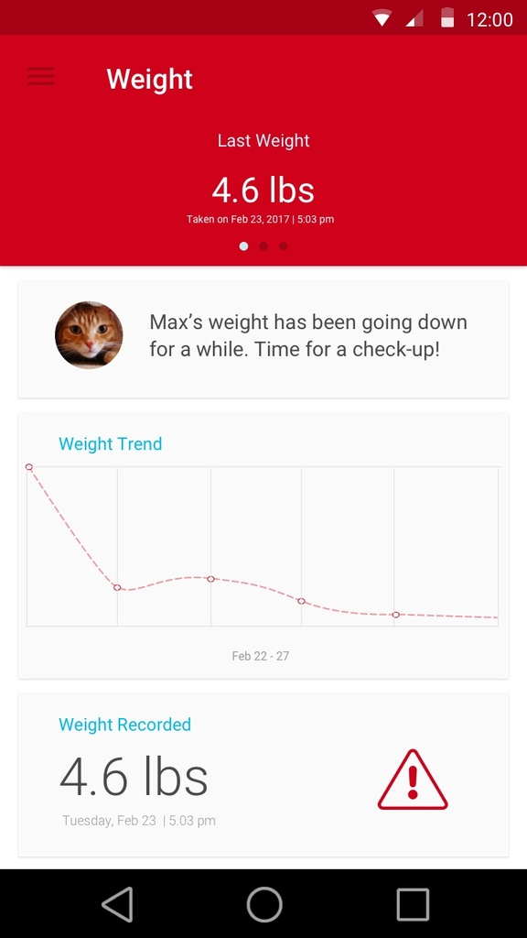
~

Slide 9
What's Next?
RFID/GPS Collar, Smart Pet Doors
Pet Accident Detection Technology: place devices in problem areas to help with housebreaking/litter box training. A noise and a whiff of citrus-eucalyptus scent delivered immediately to deter the offender, a notification to whomever is going to clean the mess, UV light to find it
Components keep getting smaller and cheaper and machine learning is a growing field...the possibilities are endless!

